Slide 1
Course Code:CSC402A Course Title: Web Architecture and Application Development
Course Leader:
Kishore S.M.
kishore.cs.et@msruas.ac.in

Slide 2
Objectives
At the end of the lecture, students will be able to
Design good software architecture
Describe quality attributes of software

Slide 3
Contents
Introduction to software architecture
Software Architectural styles
Quality attributes of software
Software structures

Slide 4
Software Architecture
The goal of software design is to build a model that meets all customer requirements and leads to successful implementation
What is architecture design?
Architecture design defines the relationship between major structural elements of the software, the styles and design patterns that can be used to achieve the requirements defined for the system, and the constraints that affect the way in which architecture can be implemented
Who is responsible for developing the architecture design?
Software architects and designers

Slide 5
Software Architecture
Why is software architecture design so important?
Poor design result in deficient product
No Reusability
Exhibits unpredictable behavior
Loss of Time and Cost
A good software design reduces the risks associated with software production
Teams can work in an orderly fashion
System Traceable for implementation and testing
Leads to a higher quality software

Slide 6
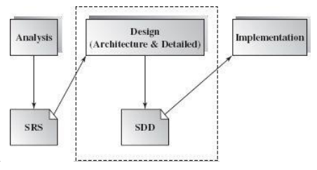
Software Architecture
Software Design
Software design is an early phase of the Software Development Life Cycle (SDLC)

Slide 7
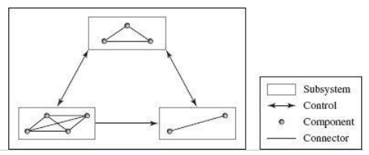
Software Architecture
Bridging Requirements and Implementation
Software architecture design provides a blueprint and guideline for developing a software system based on its requirement analysis specification.

Slide 8
Architecture Styles
An architecture style contains a set of rules, constraints, and patterns of how to structure a system into a set of elements and connectors.
The key components of an architecture style are:
Elements that perform functions required by a system
Connectors that enable communication, coordination, and cooperation among elements
Constraints that define how elements can be integrated to form the system
Attributes that describe the advantages and disadvantages of the chosen structure

Slide 9
Quality Attributes in Software
Quality attributes can be categorized into the following three groups:
Implementation attributes (not observable at runtime)
Interoperability
Maintainability and extensibility
Testability
Portability
Scalability
Flexibility
2. Runtime attributes (observable at runtime)
Availability
Security
Performance

Slide 10
Quality Attributes in Software
Usability
Reliability
Maintainability
3. Business attributes
Time to market
Cost
Lifetime

Slide 11
Quality Attributes in Software
Implementation attributes
• Interoperability: universal accessibility and the ability to exchange data among internal components and with the outside world. Interoperability requires loose dependency of infrastructure
• Maintainability and extensibility: The ability to modify the system and conveniently extend it
• Testability: The degree to which the system facilitates the establishment of test cases. Testability usually requires a complete set of documentation accompanied by system design and implementation
• Portability: The system's level of independence on software and hardware platforms. Systems developed using high-level programming languages usually have good portability. One typical example is Java—most Java programs need only be compiled once and can run everywhere

Slide 12
Quality Attributes in Software
• Scalability: A system's ability to adapt to an increase in user requests. Scalability disfavors bottlenecks in system design
• Flexibility: The ease of system modification to cater to different environments or problems for which the system was not originally designed. Systems developed using component-based architecture or service-oriented architecture usually possess this attribute

Slide 13
Quality Attributes in Software
Runtime attributes
• Availability: A system's capability to be available 24/7. Availability can be achieved via replication and careful design to cope with failures of hardware, software, or the network
• Security: A system's ability to cope with malicious attacks from outside or inside the system. Security can be improved by installing firewalls, establishing authentication and authorization processes, and using encryption
• Performance: Increasing a system's efficiency with regard to Response time, throughput, and resource utilization, attributes which usually conflict with each other

Slide 14
Quality Attributes in Software
• Usability: The level of human satisfaction from using the system. Usability includes matters of completeness, correctness, compatibility, as well as a friendly user interface, complete documentation, and technical support
• Reliability: The failure frequency, the accuracy of output results, the Mean-Time-to-Failure (MTTF), the ability to recover from failure, and the failure predictability
• Maintainability (extensibility, adaptability, serviceability, testability, compatibility, and configurability): the ease of software system change

Slide 15
Quality Attributes in Software
Business attributes
• Time to market: The time it takes from requirements analysis to the date a product is released
• Cost: The expense of building, maintaining, and operating the system
• Lifetime: The period of time that the product is “alive” before retirement

Slide 16
Software Structures
A software architecture design can be described with various software structures, each from a different perspective
Static structure - It may be described in terms of software code units like source/binary code files, software modules, or software component deployment units
Runtime Structure - . It may also be described based on the runtime dynamic structure, in which the software elements are threads, processes, sessions, transactions, objects, or software component instances at execution time
Management Structure - An allocation structure may also be used to describe the project management structure of an architecture design

Slide 17
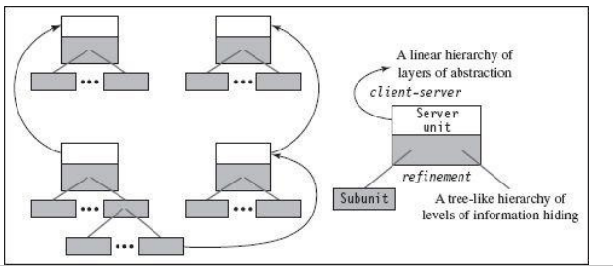
Software Structures
Software Static structure
A software project is typically implemented in multiple files
This includes static file types such as executable files, library files, binary software component modules (usually in the form of DLLs [dynamic linking libraries], JavaBeans, and Enterprise JavaBeans); deployment descriptors and other resource files

Slide 18
Software Structures
Here connectors may exhibit the following attributes:
Direction: If module A invokes a method of module B during execution, there is a unidirectional connector from module A to module B
Synchronization: A method invocation can be synchronous or asynchronous
Sequence: Some connectors must be used in a particular sequence

Slide 19
Summary
Architecture design defines the relationship between major structural elements of the software, the styles and design patterns
A good software design reduces the risks associated with software production
Attributes of software connectors are direction, synchronization and sequence

